Slide 1


Optimizing of Controller Placement based on Hybrid GenClust Algorithm for DDOS Mitigation on Software Defined Network
Master of Science in Computer Engineering
Sahaj Shakya
2019-1-39-0020
Nepal College of Information Technology
Faculty of Science and Technology
Pokhara University, Nepal
January 28th , 2021

Slide 2

Outlines
01
BACKGOUND
02
PROBLEM STATEMENTS
03
SIGNIFICANCE OF STUDY
04
LITERATURE REVIEW
05
PROPOSED METHODOLOGY
06
EXPECTED OUTPUT
07
VALIDATION CRITERIA
08
REFERENCES

Slide 3
1. BACKGROUND

Slide 4
Background
BOTNETS
ATTACKER
VICTIM
4

Slide 5
2. PROBLEM STATEMENTS
“The first step to solve a problem is to find the problem.”

Slide 6
Problem Statement
Impact of a DDOS attack usually consists of loss of services.
In case of DDOS detection and prevention based (Research Gap).
Maximum Controller detection overhead [1]
150 switches in a system can handle up to 20,000 new flow requests.
computational overhead impact controller performance.
multiple OpenFlow controllers mitigate the problem
False Negative and False Positive Value
False negative values when parameter set to a low value. [6]
Attacker will low flow does less damage
Multiple combination of machine learning algorithm mitigate the problem [2]
6

Slide 7
3. SIGNIFICANCE OF STUDY
(Based on Objectives)

Slide 8
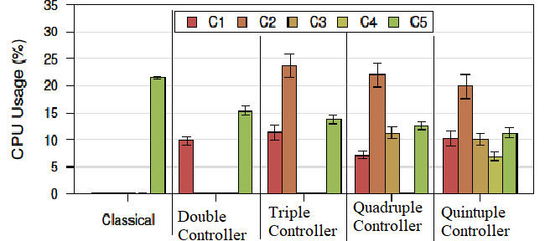
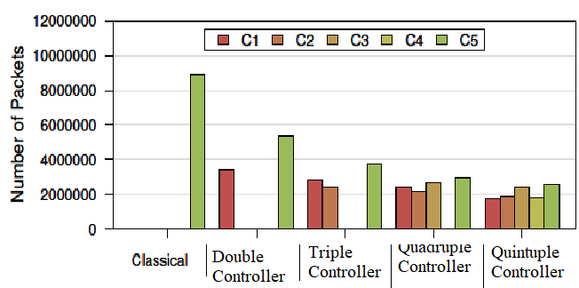
Significance of Study
To mitigate the Single Point Failure and overhead of Controller
Fig 3.1 Comparison of Controller overhead based on Patgen VS Classical Single Controller placement
8

Slide 9
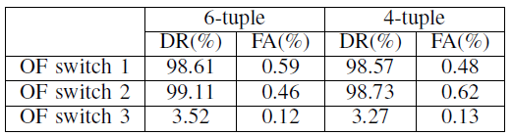
Significance of Study
To reduce the false positive detection in case of Slow Attack
Average sum of packet flow, average byte per flow, average duration of flow, average pair of flow, Growth of single flow and Growth of different flow
Fig 3.2 Comparison of Detection Rate and False Positive Alarm based on Nox Controller Ddos Detection
9

Slide 10
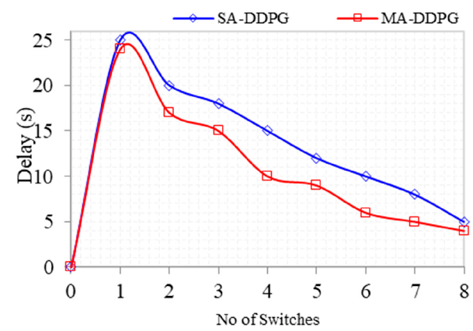
Significance of Study
To introduce Multiagent system in SDN
Fig 3.3 Comparison of Multiagent vs Single Agent System based on Multi-Agent Reinforcement Learning Framework in SDN-IoT
10

Slide 11
4. LITERATURE REVIEW

Slide 12
Literature Review
In case of “Lightweight DDoS Flooding Attack Detection Using NOX/OpenFlow”,
multiple parameters for calculation of the current state.
prevent problems arising from smooth packet replay attacks.
the false positive rate of this entropy reduced by 12%.
As per “Evaluating the Controller Capacity in SDN “,
issue with the OpenFlow architecture capacity defined.
queuing theory is used to analyse controller performance.
150 switches, only 20,000 new flow requests can be handled.
As per “QoS improvement with an optimum controller selection for software-defined networks“,
multiple-criteria decision parameter for multiple controllers based on ANP.
performance comparison for improvement in QoS.
Best controller is selected.
As per “PATGEN“,
reducing the effects of attacks
Increase efficiency of the multi-controller SDN
12

Slide 13
5. METHODOLOGY

Slide 14
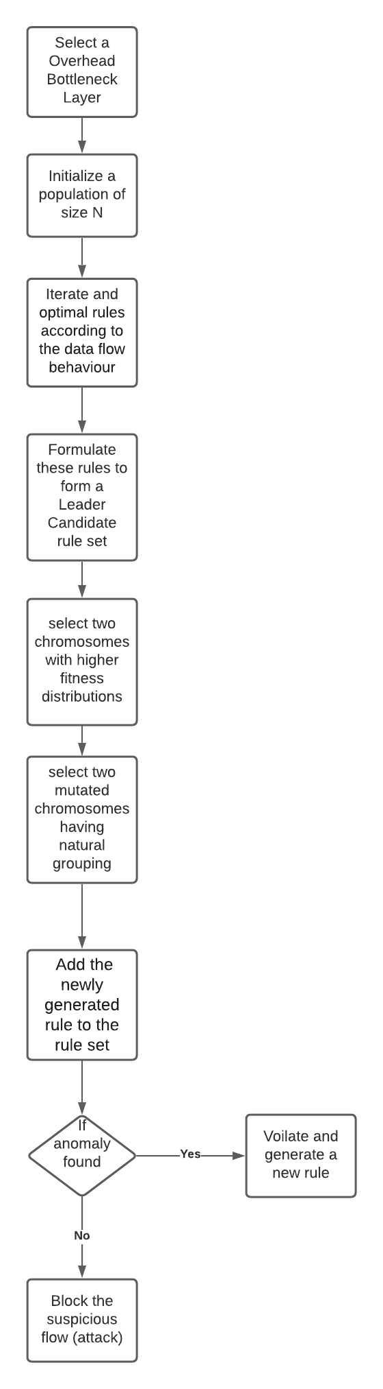
Purposed Methodology
Emulation can be done on mininet
steps are divided into three phases.
bottleneck discovery, selection, and creation.
Detection
detection phase identifies the overloaded controller.
Selection
Election phase identifies controllers as a leader, vice leader and elite.
leader seeks the optimal cluster configuration.
Creation
Create new rules to handle flow request.
Selection
VL as leader if a leader is targeted by a DDoS attack.
Create new rules
14

Slide 15
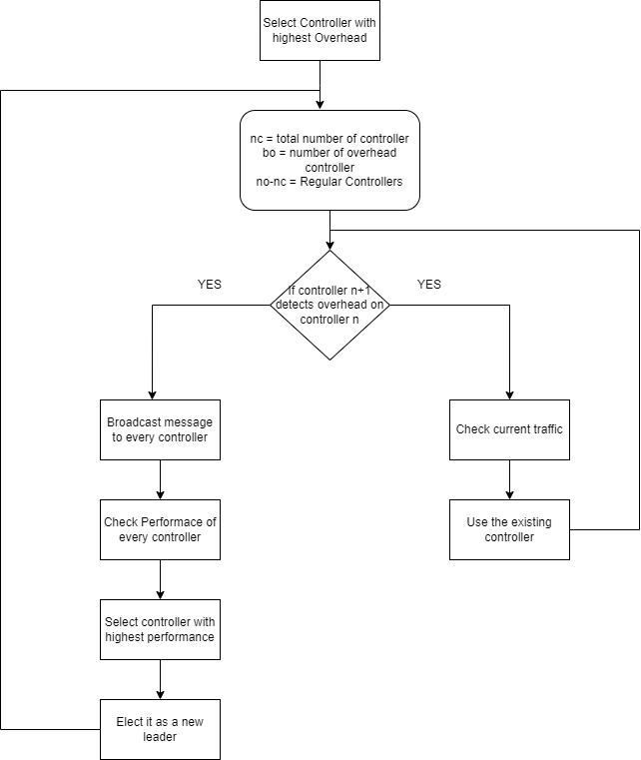
Purposed Methodology
Selection Criteria
15

Slide 16
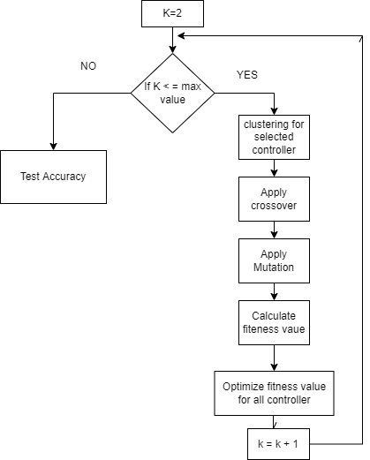
Purposed Methodology
Selection Criteria to minimize fitness value
Initially k = 2
Mutation rate of 0.01
Scale of Fitness = [-1, 1]
16

Slide 17
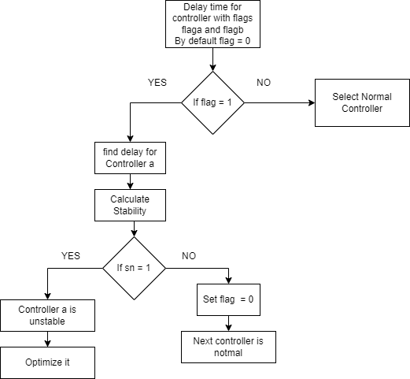
Purposed Methodology
Detection of overhead
17

Slide 18
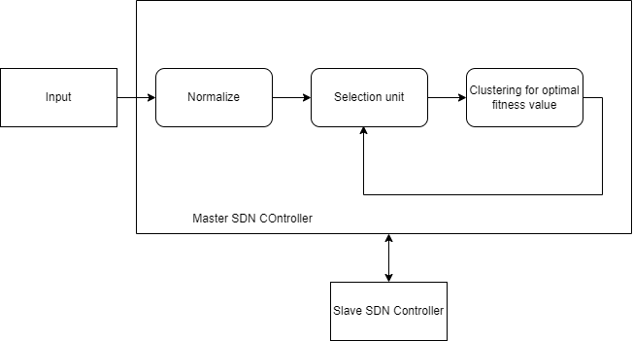
Purposed Methodology
Framework
Alert
18

Slide 19
6. EXPECTED OUTPUT

Slide 20
Expected Output
To detect how larger network data is spread
To select the efficient controller positions
To reduce overhead
To provide a powerful visualization model for control and monitor of Network Flow
20

Slide 21
7. VALIDATION CRITERIA

Slide 22


Validation Criteria
dividing an initial sample set into training and validation datasets.
inferring the model with the training dataset.
evaluating the model's quality with the validation dataset.
CPU speed, delay, Network fluctuations are analysed and Detection rate is determined.
The detection rate classifies the traffic as legitimate or not
22

Slide 23
8. REFERENCES

Slide 24
References
[1] L. Yao, P. Hong and W. Zhou, "Evaluating the controller capacity in software defined networking," 2014 23rd International Conference on Computer Communication and Networks (ICCCN), 2014, pp. 1-6, doi: 10.1109/ICCCN.2014.6911857.
[2] Ali J, Roh Bh, Lee S, “QoS improvement with an optimum controller selection for software-defined networks,”, 2019, PLOS ONE 14(5): e0217631, doi: 10.1371/journal.pone.0217631
[3] Nam, Tran Manh et al. “Self-organizing map-based approaches in DDoS flooding detection using SDN.” 2018 International Conference on Information Networking (ICOIN) (2018): 249-254.
[4] Jagdeep Singh, Sunny Behal, Detection and mitigation of DDoS attacks in SDN: A comprehensive review, research challenges and future directions, Computer Science Review, Volume 37, 2020, 100279, ISSN 1574-0137, doi: 10.1016/j.cosrev.2020.100279.
24

Slide 25
References
[5] P. Preamthaisong, A. Auyporntrakool, P. Aimtongkham, T. Sriwuttisap and C. So-In, "Enhanced DDoS Detection using Hybrid Genetic Algorithm and Decision Tree for SDN," 2019 16th International Joint Conference on Computer Science and Software Engineering (JCSSE), 2019, pp. 152-157, doi: 10.1109/JCSSE.2019.8864216.
[6] R. Braga, E. Mota and A. Passito, "Lightweight DDoS flooding attack detection using NOX/OpenFlow," IEEE Local Computer Network Conference, 2010, pp. 408-415, doi: 10.1109/LCN.2010.5735752.
[7] Harikrishna, P., Amuthan, A. SDN-based DDoS Attack Mitigation Scheme using Convolution Recursively Enhanced Self Organizing Maps. Sādhanā 45, 104 (2020). Doi: 10.1007/s12046-020-01353-x
[8] Karnwal, Tarun & Sivakumar, T. & Gnanasekaran, Aghila. (2012). A filter tree approach to protect cloud computing against XML DDoS and HTTP DDoS attack. Advances in Intelligent Systems and Computing. 182. 10.1109/SCEECS.2012.6184829.
25

Slide 26
References
[9] S. M. Mousavi and M. St-Hilaire, "Early detection of DDoS attacks against SDN controllers," 2015 International Conference on Computing, Networking and Communications (ICNC), 2015, pp. 77-81, doi: 10.1109/ICCNC.2015.7069319.
[10] S. Dong and M. Sarem, "DDoS Attack Detection Method Based on Improved KNN With the Degree of DDoS Attack in Software-Defined Networks," in IEEE Access, vol. 8, pp. 5039-5048, 2020, doi: 10.1109/ACCESS.2019.2963077.
[11] H. Peng, Z. Sun, X. Zhao, S. Tan and Z. Sun, "A Detection Method for Anomaly Flow in Software Defined Network," in IEEE Access, vol. 6, pp. 27809-27817, 2018, doi: 10.1109/ACCESS.2018.2839684.
[12] Seungwon, Shin & Yegneswaran, Vinod & Porras, Phillip & Gu, Guofei. (2013). AVANT-GUARD: scalable and vigilant switch flow management in software-defined networks. 10.1145/2508859.2516684.
26

Slide 27
References
[13] Ambrosin, Moreno & Conti, Mauro & De Gaspari, Fabio & Poovendran, Radha. (2015). LineSwitch: Efficiently Managing Switch Flow in Software-Defined Networking while Effectively Tackling DoS Attacks. ASIACCS 2015 - Proceedings of the 10th ACM Symposium on Information, Computer and Communications Security. 10.1145/2714576.2714612.
[14] Iranmanesh, Amir & Naji, Hamid. (2021). A protocol for cluster confirmations of SDN controllers against DDoS attacks. Computers & Electrical Engineering. Volume 93. 10.1016/j.compeleceng.2021.107265.
[15] Islam, Md & Estivill-Castro, Vladimir & Rahman, Md Anisur & Bossomaier, Terry. (2017). Combining K-Means and a Genetic Algorithm through a Novel Arrangement of Genetic Operators for High Quality Clustering. Expert Systems with Applications. 91. 402-417. 10.1016/j.eswa.2017.09.005.
27

Slide 28
QUESTIONS

